Slide 1
Performance 1: Overview & Latency
Source of most materials:
Xiwei Xu, Ingo Weber, and Mark Staples. Architecture for Blockchain Applications. Springer, 2019

Slide 2
What will you learn this week?
Performance Overview
Latency
Transaction Inclusion in Public Blockchain
Simulating Latency
Throughput

Slide 3
Performance Overview

Slide 4
ISO/IEC 25010:2011 Quality Model
Functional suitability
Functional correctness
Functional complete-ness
Performance efficiency
Capacity
Resource utilization
Functional appropriate-ness
Time behavior
Compatib-ility
Interop-erability
Co-existence
Usability
Operability
User error protection
Reliability
Availability
Recoverab-ility
Maturity
Fault tolerance
Security
Integrity
Confidential-ity
Non-repudiation
Accountab-ility
Authent-icity
Maintain-ability
Modularity
Reuseability
Modifiab-ility
Testability
Analyzab-ility
Portability
Installability
Replace-ability
Adaptability
Notes:
International standards for evaluation of software quality
Blockchain has good and bad quality

Slide 5
Performance-Related Considerations
Background
Sustained
Increasing
Stress
Standard benchmarks
Representative?
Production
…
Network
Memory
CPU
Disk
…
Load
Resources
System
Scalability
Latency
Throughput
Timeliness
…
Performance
Resource Utilization
Capacity
Bottlenecks
Efficiency
Notes:
10. Performance

Slide 6
Some Important Varieties of Performance
Latency
How quickly does the system respond to a request?
Throughput
How many requests can the system process in a fixed unit of time?
Timeliness
Will the system always process a request in a specified time window?
Scalability is an orthogonal issue
How does <performance> change under increasing load & system resources?
(Can also be about the response of a system when decreasing resources, under variable load)

Slide 7
To Understand Performance, You Need Measurements
Application-Level measurements
Overall performance; check requirements met; validate results from detailed models
Component-Level measurements / Micro-benchmarking
Piece-wise drivers of performance; observe interactions; identity bottlenecks
Load testing – check system response & utilisation under increasing load
Stress Testing – check maximum capacity; find resource bottlenecks
Soak Testing – check system response under long-duration load
“Benchmarking crimes” – what not to do:
https://www.cse.unsw.edu.au/~gernot/benchmarking-crimes.html

Slide 8
Predicting Performance?
Only needs a design & benchmarks
Highly approximate
Analytic formulae
Highly abstract/simplified models
Quick & dirty
Only needs design & component benchmarks
Can be done before developing the system
Simulation
Uses a model; many abstractions/simplifications
Only needs a design & benchmarks, but takes work
Starts to explore variation & interactions
Can be done before developing the system
Monitoring
Needs real deployed system
Needs a monitoring framework
Most valid results; e.g. actual effects!
Needs a real deployed system
Most valid results

Slide 9
Some Resources in Blockchains
For public blockchains
Cryptocurrency for Transaction Fees
Can affect probability of transaction inclusion (impacts transaction latency)
Mining difficulty for Proof of Work
Gas & Block Gas Limits (e.g. in Ethereum)
More of an Availability problem as discussed in lectures on dependability and security
Network capacity including speed of light for global transaction & block propagation
Impacts consensus for transaction inclusion latency
Transaction throughput capacity
Latency will be impacted when system is overloaded beyond capacity
For private blockchains / running a node for a public blockchain
Normal cloud/enterprise server & network resource considerations
…and most of the above, depending on blockchain configuration

Slide 10
Latency

Slide 11
Transaction Inclusion Time in Public Blockchain…
mining
mining
Timeline
(not to scale)
t0 start mining on previous candidate block
t1
Tx sent
t2
miner includes Tx in candidate block
t3
Tx is observed in new mined block
interblock time / 2
+
interblock time

Slide 12



Student Task
How long does it take to get a transaction committed in Bitcoin?
Assume 10 minutes interblock time and 6 confirmations

Slide 13
… Plus Extra Small Bits of Time
Timeline
(not to scale)
t1
Tx sent
t3’
Tx is observed in new block
t1’
Tx arrives at miner
t2’
miner includes Tx in new candidate block
t0 prev candidate block
t3
block is mined
t2
block is mined
https://ethstats.net/
Tx propagation time
+
interblock time / 2
+ block prep time
interblock time
(includes block prep time)
+
+
block propagation time

Slide 14
… Also, Major Sources of Variation in Latency
Probability of Tx inclusion? May have to wait for another block. Also, affected by fees…
Timeline
(not to scale)
Arrival time within mining window?
t0 start mining on previous candidate block
t1
Tx sent
t2
miner includes Tx in candidate block
t3
Tx is observed in new mined block
Previous interblock time?
Current interblock time?

Slide 15
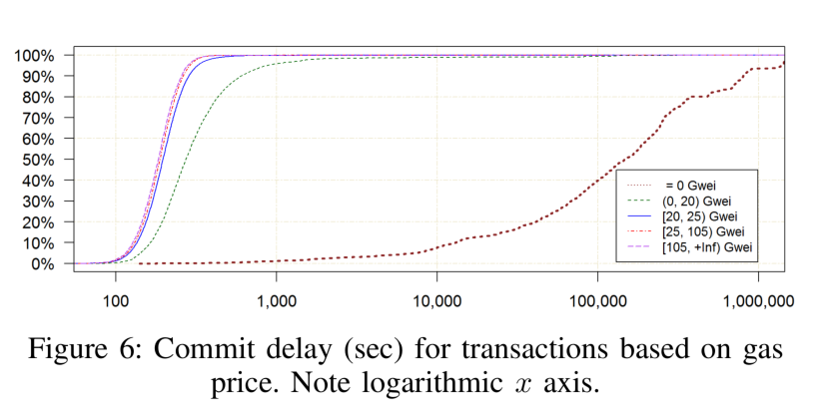
Upshot is High Variation of Latency
On Ethereum: not 1.5 x interblock time; in practice more like ~1.8 x inter-block time?
But with a lot of variation! Some caused by Tx fee, gas fee, etc.
You need to design your system to cope with this to meet requirements
N.B.: 11 “confirmation blocks” add a large
“constant”-ish factor on the main cause of difference
in latency variation
Notes:
Even though blockchain replace the need of trusted third party, the latency of blockchain can be a major drawback. In a blockchain using Nakamoto consensus, to confirm a transaction, it needs to be included in a block, which should be endorsed by dependent blocks, known as confirmation blocks.
On Bitcoin the inter-block time is about 10 minutes and 6 confirmation blocks are often used while on the public Ethereum blockchain the average block generation time is about 15s and 12 confirmation blocks are typically recommended. As you can see, the latency incur to the system will be high in magnitudes.
Additionally, Transaction delays can also arise from network delays, the transaction fee offered, the number of transactions being processed, and the strategic decisions made by miners. So, transaction inclusion times can vary widely.
Although longer than in conventional systems, these transaction latencies may be acceptable for some use cases. it will still be important to be able to accurately predict system-level latency during the design phase, to assess the impact of this limitation on system requirements

Slide 16
An Aside: Transaction Inclusion with Proof of Authority in Private Blockchain
Timeline
(not to scale)
Assuming transaction arrives before the small window near end of interblock time where the next block is constructed by the Authority, i.e. t1 < t2
This can be tricky because interblock time tends to be much smaller in private blockchains, but tends to have much lower transaction latency anyway
(no or few confirmation blocks)
t0 previous block
t2
“miner” includes Tx in candidate block
t1
Tx sent
t3
Tx is observed in new block
interblock time / 2

Slide 17
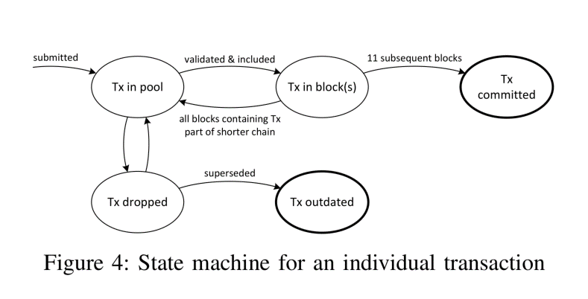
In Public Blockchains, Wait for Confirmation Blocks
Nakamoto consensus can create “uncle” blocks
Blockchains using Proof-of-Work, Proof-of-Stake, …
Transaction you saw in a block turns out not to have been officially included in the blockchain (not in main chain, only in uncle block)
Only probabilistic, long-run, transaction commit
Can increase confidence your transaction is really included, by waiting for subsequent “confirmation blocks”
For Bitcoin, often people say wait 6 blocks
For Ethereum, often people say wait 12 blocks
(Lower interblock time can increase likelihood of uncles)
Waiting for confirmation blocks increases latency, and increases latency variability
But increases confidence in finality

Slide 18
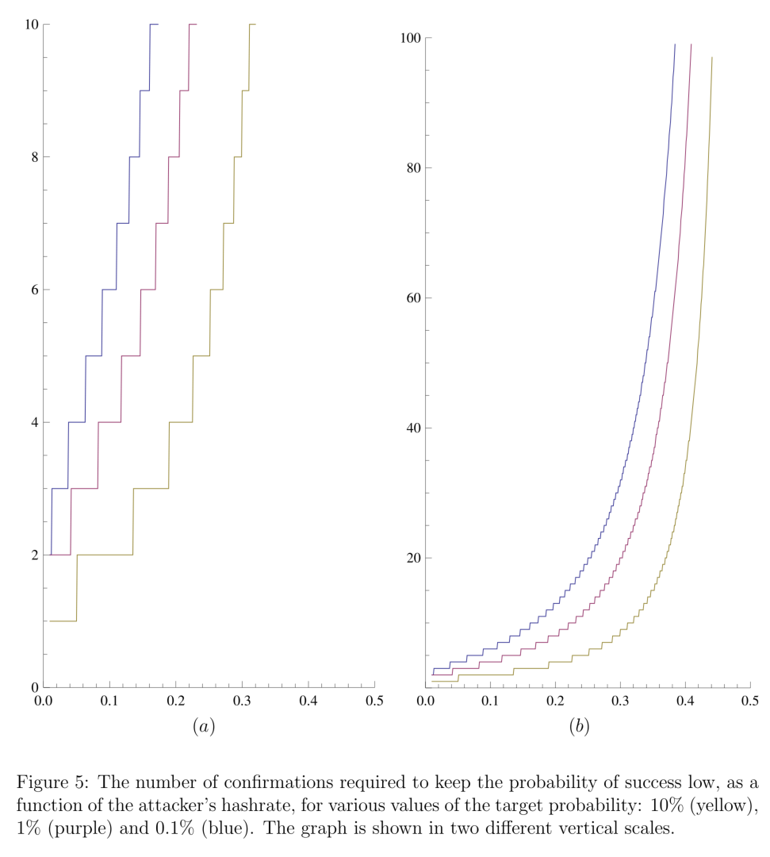

Confirmations: Inclusion Confidence vs. Latency
Should be risk-based: how much confidence vs. how much latency?
“Analysis of hashrate-based double spending”
https://arxiv.org/abs/1402.2009

Slide 19
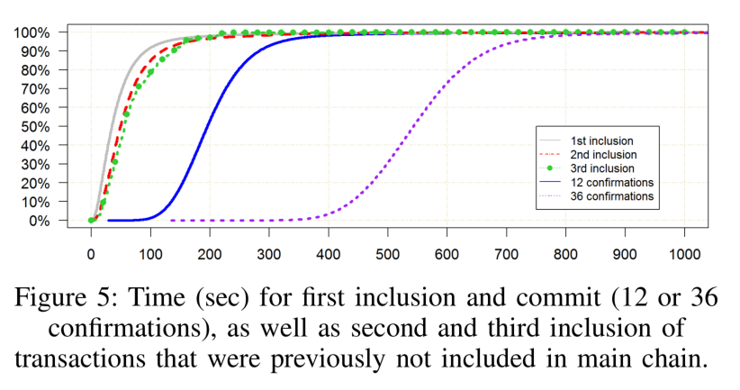

Confirmations: Inclusion Confidence vs. Latency
Should be risk-based: how much confidence vs. how much latency?
confirmation blocks: 6
Blue line: 0.1% chance of successful double-spend
0.1 → 10% of hashrate
“On Availability for Blockchain-Based Systems”
https://research.csiro.au/data61/wp-content/uploads/sites/85/2016/08/OnAvailabilityForBlockchain-BasedSystems-SRDS2017-authors-copy.pdf
“Analysis of hashrate-based double spending”
https://arxiv.org/abs/1402.2009

Slide 20
Student Task
How can architects influence Tx latency?

Slide 21
How Architects Can Influence Transaction Latency
Offer a Transaction fee that meets/exceeds miners’ expectations
Ethereum “fee” is gas price * gas used
Gas price is user-defined
Choose smallest number of confirmation blocks that is “safe” for your application
Use another blockchain (private? or a public blockchain that works “better”?)
Configure blockchain to use other consensus algorithms (PBFT, PoA, …)
Avoid Nakamoto consensus & possibility of uncles, so you can avoid confirmation blocks
Configure blockchain to target a small interblock time
Work off-chain, e.g. using “state channel” design pattern, to be discussed in later lectures

Slide 22
Performance 1: Overview & Latency
Source of most materials:
Xiwei Xu, Ingo Weber, and Mark Staples. Architecture for Blockchain Applications. Springer, 2019

